Slide 1
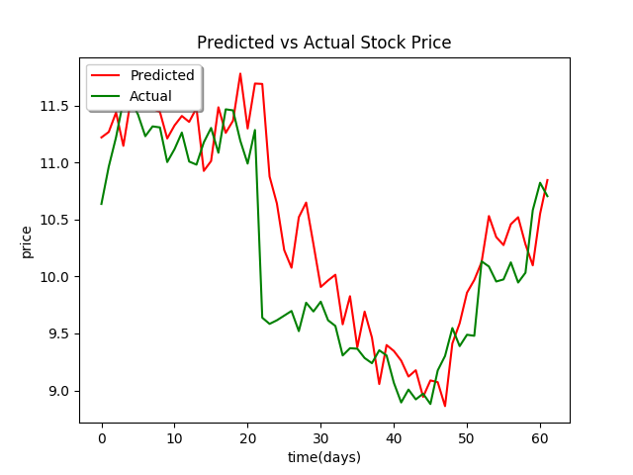
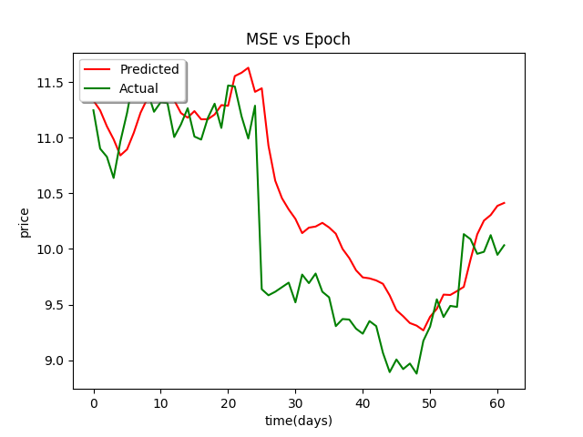
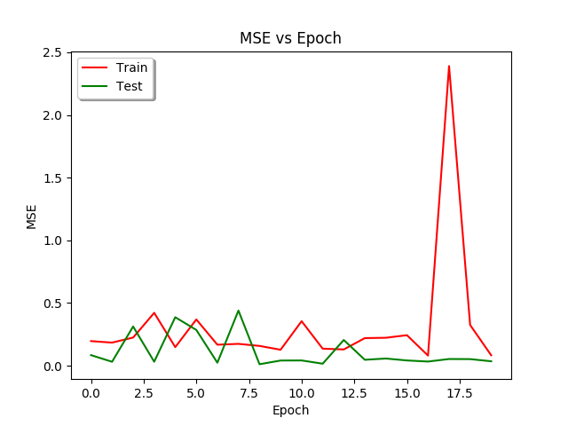
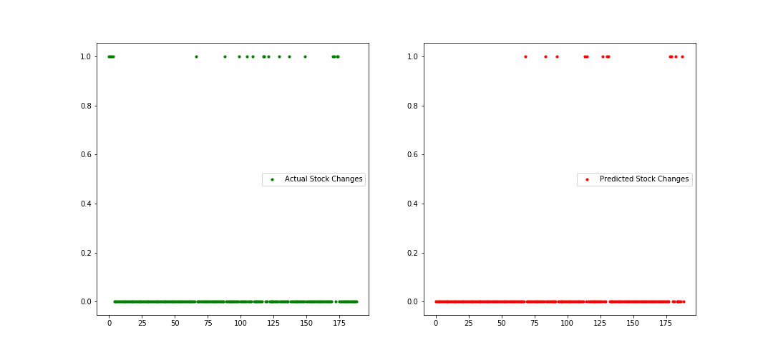



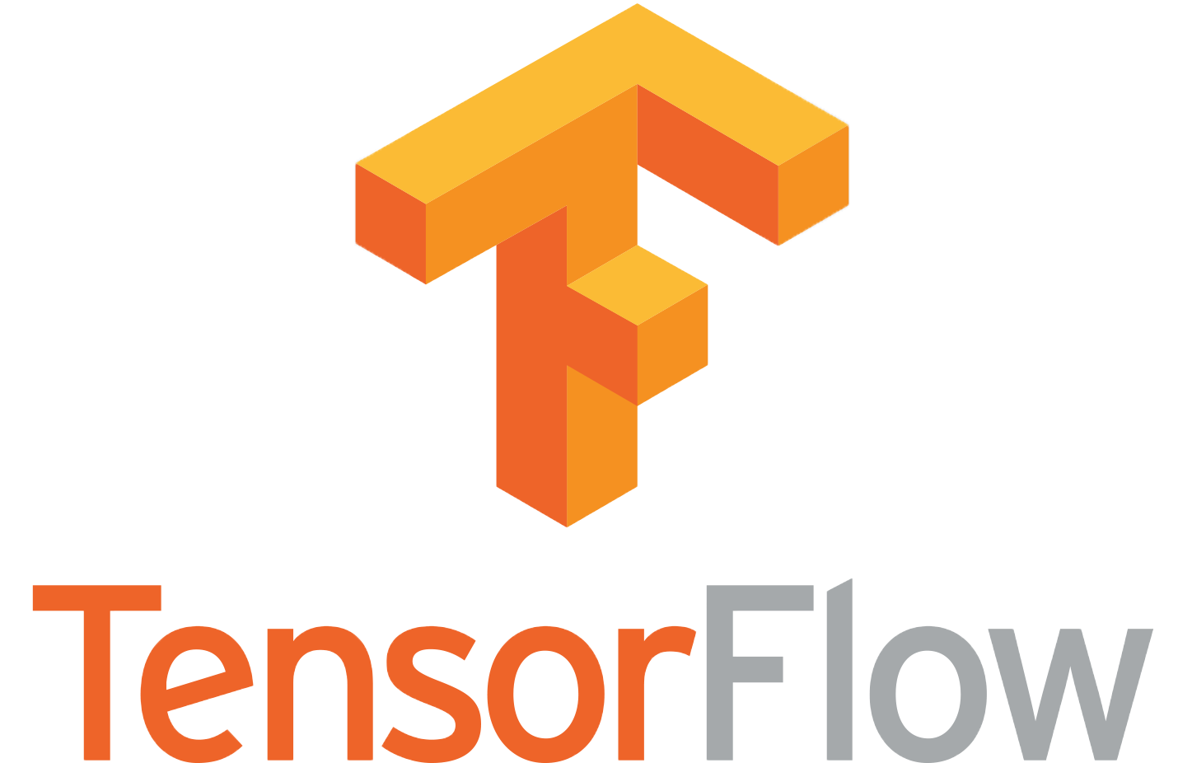


CSCI 5622 Graduate Machine Learning Final Project
Using Media Data to Predict Stock Fluctuations
Mary Letey Morgan Allen Colton Williams Aniq Shahid
Main Focus
Results
Results
Research project investigating relationships between media concerning a company and that company's stock price.
Theoretically, the stock price of a company is based in part on public perception of their market. This perception can easily be affected by media sources. The project team hypothesizes that social media sources and news sources may be used to predict daily stock price fluctuations within the technology industry.
This team was able to construct a model that predicts the closing stock price with around 3% error.
Figure 1 and Table 1 show how Google Trends were a very effective predictor of stock price in a regression model
Figure 2 and Table 2 show how article text data was an effective predictor of stock price in a logistic regression model
Topic modelling is commonly used in Natural Language Processing (NLP) to reduce a large number of sparse features into dense and meaningful topic
Table 3 gives insight into the main “breakdown” of our text data. These topic classes became features in our main RNN model.
The RNN model, a NN model that adapts to and “remembers” previous data, used current features, such as raw text data, 25 classes generated by topic modeling, and google trends to ultimately predict the closing stock price.
Figures 3a and 3b show the predictions and model accuracy for the total RNN model. The testing accuracy is quite high, on average 3% error.
It’s worthwhile noticing from Figure 3a that the RNN model almost always overestimated the stock price. In addition, the predicted values also had significantly less variance than the actual stock values. This can lead the model to be better predicting long-term trends as opposed to short term valuations.
Company | MSE (%)
HP | 0.9
IBM | 4.0
Intel | 0.7
Seagate | 1.0
West Dig | 0.6
Predicted Vs Actual
Figure 1. Regression Results
Regression results using Google trends data for company Seagate
Table 1. Mean Squared Error
Error from the regression model by company
Motivation
Figure 3a. RNN with Topic Modeling Features
Complete RNN model predictions for HP
Considering the most basic supply-demand model in economics, stock prices are functions of the supply and demand for ownership in a company. Because the "consumers" in this supply and demand model are viewing a stock as an investment, demand represents confidence in the performance of the company. Furthermore, an increasing stock price represents increased confidence in the potential of the company. Thus the stock price may be affected by a change in the public's understanding of a company's perceived growth and risk. Forms of media, such as news articles, may have a huge impact in these perceptions.
This project will examine the extent to which media sources affect stock prices, and how well we can use media data to predict stock price changes.
Company | Accuracy (%)
HP | 85
IBM | 76
Intel* | ---
Seagate | 84
West Dig* | ---
Figure 2. Logistic Regression Results
Stock increase/decrease predictions based on article data for Seagate.
0 represents decrease from previous day; 1 increase
Table 2. Testing Accuracy
Error from the logistic regression text model by company
Figure 3b. MSE vs Epochs
Relationship between MSE and number of epochs in RNN model for HP
Data and Methods
Numerical Data from Bloomberg recording daily stock price
Google Trends measuring how often companies are searched
Text Data from news sources scraped off the web
Companies representing the technology industry
HP
IBM
Intel
Seagate
Western Digital
Regression to establish a relationship between stock price and google trends
Logistic Regression to model impact of words on an up-down change in the stock price
Topic Modeling to determine different themes occurring within articles
Recurrent Neural Network (RNN) as our main learning model which takes numerical, textual and google trends data and outputs final price prediction
Topic |  |  |  | Words
Topic 1 | Devices | Share Buyback | Strategic | Win
Topic 2 | Price | Provided | Buy right | Revenues
Topic 3 | Company | Stock | Market | NYSE
Topic 4 | Packard | Buying | Company | IBM
Topic 5 | Revenue | Year | New | Development
Topic 6 | IBM | Intel | Data | Year
Conclusions and Discussion
The team was able to flesh out a solid model, with low error rates. This model can easily be built upon to include more data sources, such as twitter and SEC data.
One of the biggest challenges was getting enough clean data from a variety of sources. Despite our best efforts, there were often significant gaps in dates between published articles.
RNN’s are potentially a great tool for stock predictions, but they require a large amount of data to achieve maximum potential. In a low data situation, a generative model is one of the best choices. However, as more data is collected and the gaps are filled, the RNN will continue to improve and eventually outperform a generative model.
Table 3. Topic Modeling Classes
Articles divided into topics, trying to find some predictive pattern buried in the data.
Resources
Graphs generated from TensorFlow and Juptyer Notebook models created by this team
* Logistic regression model data not currently available

